Slide 1
Heat Transfer Determination Using Thermochromic Liquid Crystals
Benoit Laveau
Institute for Energy Technology
ETH Zurich, Switzerland

Slide 2
Outline
Introduction to Heat Transfer
Measurement Methods
Liquid Crystals
The TLC Experiment

Slide 3
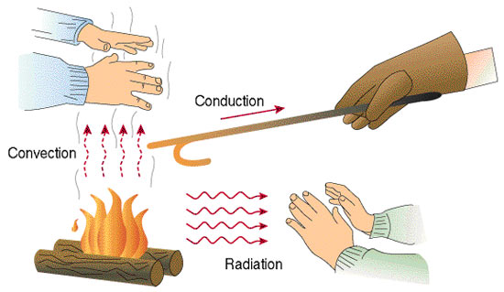
Heat Transfer Mechanisms
Conduction
  Heat Conduction Eq.
  Thermal Conductivity
Convection
  Free Convection
  Forced Convection
Radiation

Slide 4
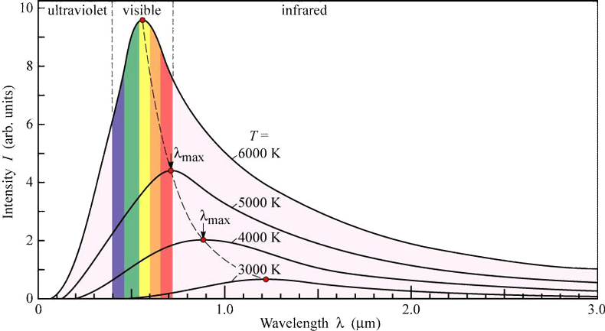

Radiation
Property of Temperature
Heat transmitted without the involvement of mass.
Spectral Energy Distribution.
  Increase of T causes reduction of λ_{max}.
  Increase of T causes increase of E_{emiss}
Important at very high temperature.
Stefan eq.
Material | Ref. Emissivity
White Paper | 0.27
Iron | 0.45
Asphalt | 0.89
Brick, red | 0.73

Slide 5
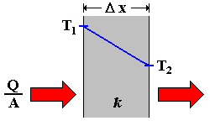
Conduction
3
2
3
1
Property of Material
Heat Transmitted Across a Mass
Heat flow per unit time (“q-dot” ):
  Area of Conductor Normal to Flow
  Conductivity of Material “k”
  Temperature Gradient (dT/dx)
Steady State: is not f(t)
Unsteady State: time is important
1
2
Material | Th. Cond. k [W m⁻¹ K⁻¹]
Air | 0.025
Water | 0.6
Glass | 1.1
Steel | 12- 45
Concrete | 1.7
Diamond | 900 - 2000

Slide 6
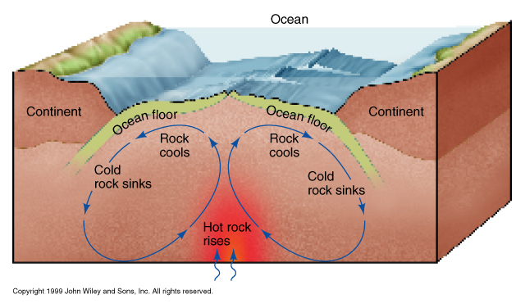
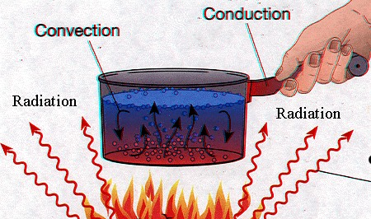

Convection
Property of Flow
Heat Transfer by means of mass movement.
Free Convection:
  Movement induced by differences in density.
Forced Convection:
  Movement induced by active mechanical means (e.g. pump)
Fluid Flow:
  Laminar
  Turbulent

Slide 7
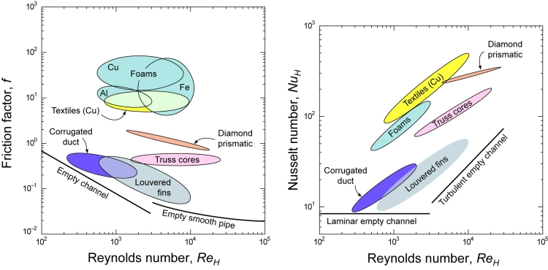
Convective vs. Conductive Heat Transfer
Nusselt Number = Convective / Conductive
h convective heat transfer coefficient
L characteristic length
k thermal conductivity of fluid

Slide 8
Dimensional Analysis
Phenomenon
Mass
Length
Time
Primary Purpose: Combine the Measurable Quantities Associated with a Phenomenon.
The Dimensions of a Measurable Quantity Are Independent of the Magnitude of Units Used.
The SI system includes 7 fundamental units, i.e. kg, m, cd, s, amp, K, mol.
Dimensional Formulas are a the Product of Powers of the Fundamental Quantities upon Which it Depends.
[“A”] = [M]^{x} [L]^{y} [T]^{z}…
Force
Pressure
Quantity | SI Units | Dimens.
Force | N | MLT⁻²
Pressure | Pa | ML⁻¹T⁻²
Heat Trans. Coef. | W m⁻² K⁻¹ | MT⁻³θ⁻¹
Therm. Cond. Coef. | W m⁻¹ K⁻¹ | MLT⁻³θ⁻¹
Heat | J | ML²T⁻²
Temperature | K | ?? ^{(*)}

Slide 9
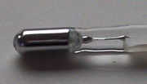
Temperature Measurement
Method | Principle | Key Specifications
Glass Thermometer | Thermal Expansion | The well known one…
Gas Thermometer | “ | Used to Calibrate other Devices
Thermocouples | Electric Potential | K:-200/+1350°, J:-40/+750°, N:>1200°, B,R,S:<1600°, E:Cryo
Langmuir Probes | “ | Used in Plasma Technology
Thermistors | Electric Resistance | Limited Ranges, Steinhart-Hart Cal.
Pyrometers | Radiation | Contactless
Infrared CCD | “ | Space/Time-Resolved
Thermochromic Liquid Crystals | Material Structure | Easy, Cheap
Further Reading: L. Michalski, et al.“Temperature Measurement”, Wiley

Slide 10
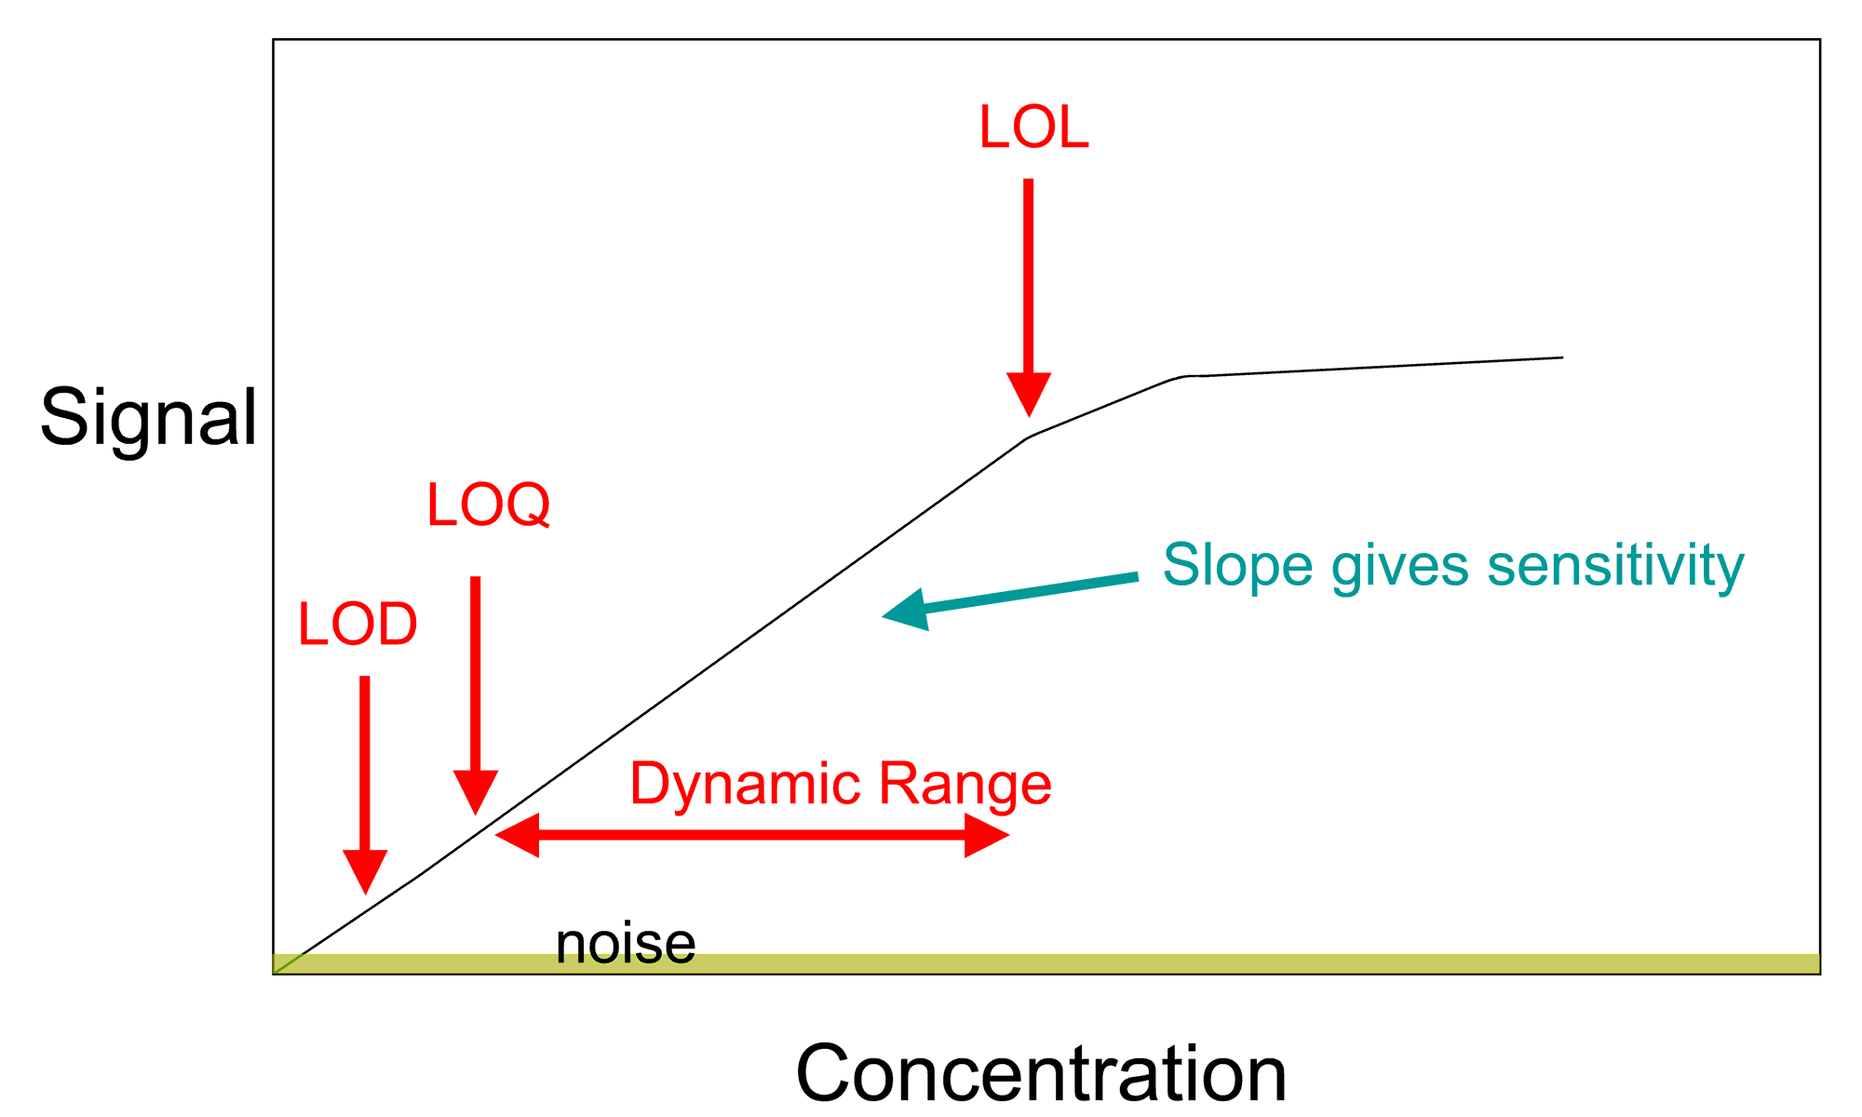
Calibration
Primary Purpose:
Relate the Measurable Quantities and the Quantity of Interest.
Based on Standards = Samples of Known Quantity of Interest.
“Eine Messung ist Keine Messung!”
Every Real Measurement Has Scatter!
  Measurement Errors.
  Counting Statistics.
  Significant Fluctuations.

Slide 11
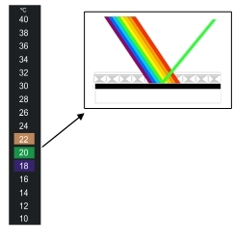
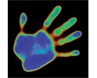
Liquid Crystals
Substances Showing Properties Between a Liquid and a Solid.
In Each Domain Molecules Are Well Ordered.
Type of Order:
  Positional
  Orientational
  Short-Range or Long-Range
Types of LC:
  Lyotropic → LC Phase Changes with Concentration of Mesogen in Solvent.
  Thermotropic → LC Phase Changes with Temperature.

Slide 12
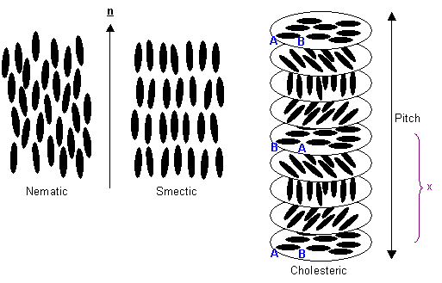
Thermochromic Liquid Crystals
f(T): Solid → LC Phases → Liquid.
LC Phases:
  Nematic: Long-Range Orientational Order
  Smectic: Long-Range Positional Order
  Cholesteric: Chiral Nematic Showing Positional Order in a Layered Structure (as in Smectic LC). The Pitch is the length Over Which the Mesogens undergo a 360° Twist.
The Pitch Changes as a function of Temperature.
Changes in Pitch Influence Thin-Film Color.

Slide 13
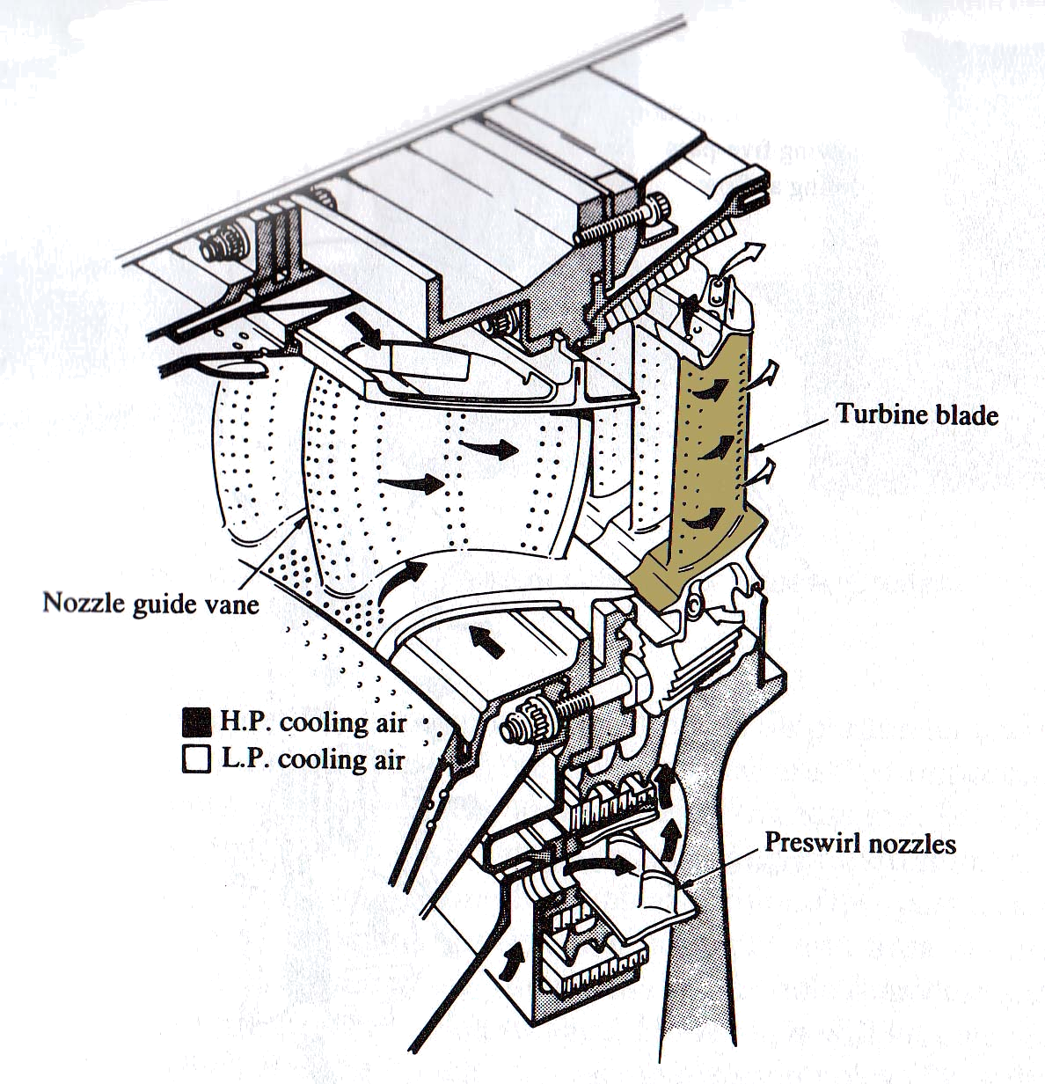
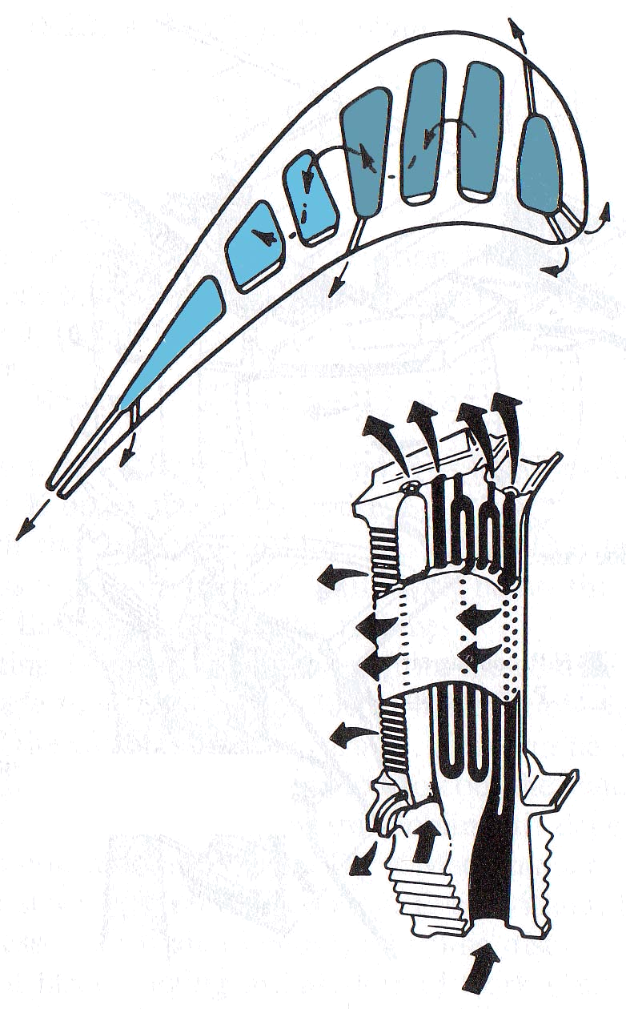
A Real Case: Turbomachinery Cooling.
Flow temperature after the combustors:
T_{flow}~1600°K > T_{melt}
=> need for efficient cooling system:
  external film cooling
  internal forced convection cooling

Slide 14
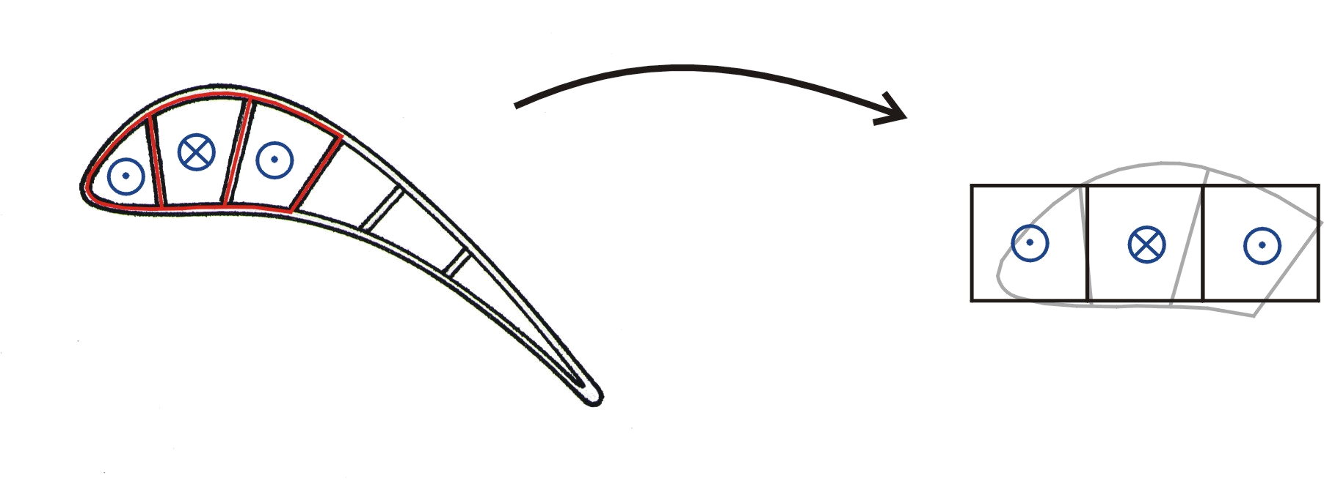
Test Section Simplifications
„only“ one cooling passage
flat cooling structure
no external flow
constant square cross section
smooth turning at top and bottom

Slide 15
Terminology
D_{h} | Hydraulic Diameter, 4*Area/Perimeter
k | Thermal Conductivity, W/(m·K)
α | Thermal Diffusivity, k/(ρC_{p}), J/(m³·K)
C_{p} | Specific Heat, J/(kg·K))
h | (Convective) Heat transfer coefficient, W/(m²K)
µ | Dynamic Viscosity, τ=µdu/dy, Pa s

Slide 16
Dimensional Analysis
Parameter |  | Engine | Model
Hydraulic diameter | [m] | 0.004 | 0.02
mass flow rate | [kg/s] | 0.0216 | 1.91
speed | [m/s] | 446.1 | 6.1
density | [kg/m³] | 3.85 | 1000
viscosity | [Pa s] | 4.5e-5 | 8.9e-4
Re = (D_{h}*V*ρ)/μ | - | 1.5e5 | 1.4e5
Matched_x001a_

Slide 17
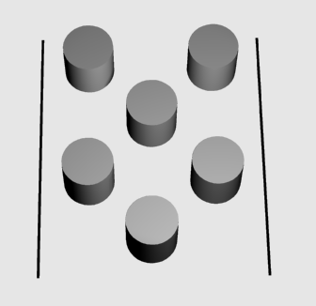


Problem Definition
Experimental examination of the heat transfer process in a cooled HPT blade
Investigations of the influence of different surface structures (rib turbulators)
Quantitative determination Nu_{D} (= h*D_{h}/ k)
Provide information for the CFD work

Slide 18





How to get h?
TLCs
Assumptions:
Semi-infinite solid
Short time constants
1D heat transfer
Aluminium plate
Boundary Conditions

Slide 19







TLC Calibration
A unique relation Color vs.Temperature
Calibration right before every test run on the test section ➔ same conditions!
Run water at known T∞ thru test section at steady state condition
T∞ | 34.8 | 35.0 | 35.2 | 35.5 | 35.7 | 36.1 | 36.7
R35C1W

Slide 20
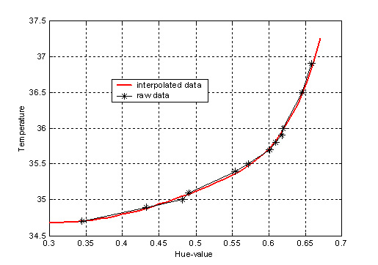
TLC Calibration
1. RGB Data
2. Conversion to HSI
3. Hue correlated to T
Polynomial interpolation by a degree of 3
(least squares)
continuous function

Slide 21
Heat Transfer Calculation
Solution:
T_{s} (at x=0):
T_{s} = f(h) !!
Numerically solved for h

